Slide 1
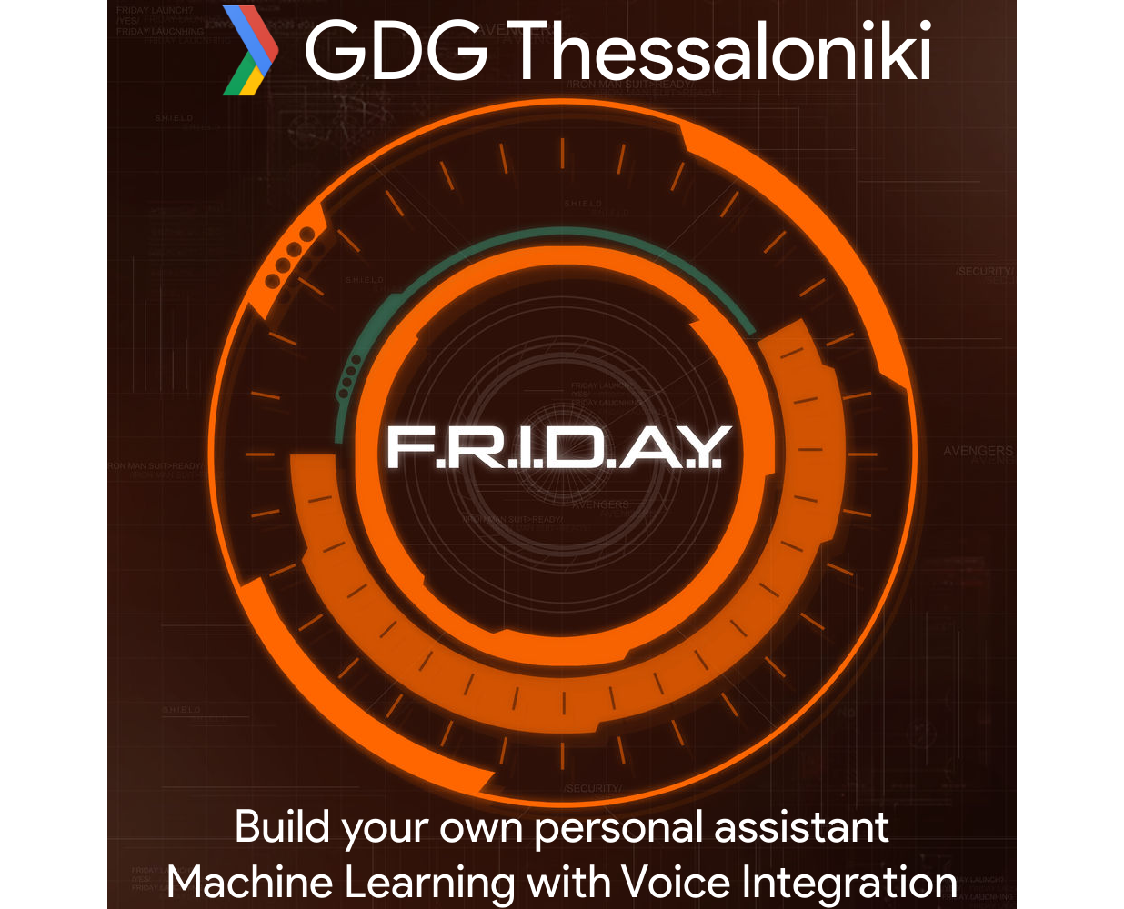

Slide 2

Where we are
i4G
AI | Voice Assistant | Working prototype
Who we are
George Kortsaridis | Christos Melidis

Slide 3
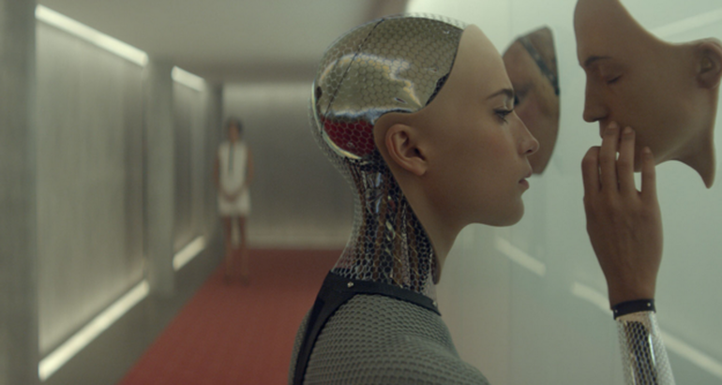
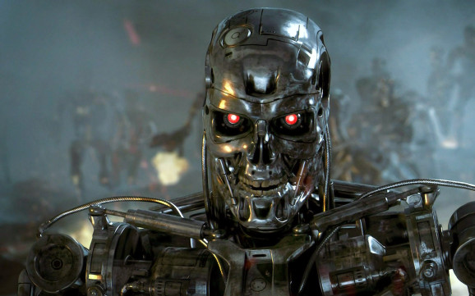

“I know what AI means... I think”

Slide 4
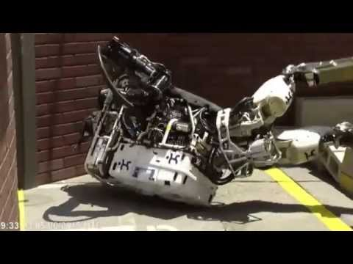
“I know what AI means... I think”

Slide 5
Intelligent behavior in an autonomous agent — THIS is AI.
AI research is leading toward something more advanced: artificial general intelligence, or AGI.
“I know what AI means... I think”

Slide 6
Artificial General Intelligence (AGI) is the intelligence which can be as intelligent as human beings.
reason, use strategy, solve puzzles, and make judgments under uncertainty;
represent knowledge, including commonsense knowledge;
plan;
learn;
communicate in natural language;
and integrate all these skills towards common goals.

Slide 7
Tests for confirming human-level AGI
The Turing Test (Turing)
The Coffee Test (Wozniak)
The Robot College Student Test (Goertzel)
The Employment Test (Nilsson)
The flat pack furniture test (Tony Severyns)

Slide 8
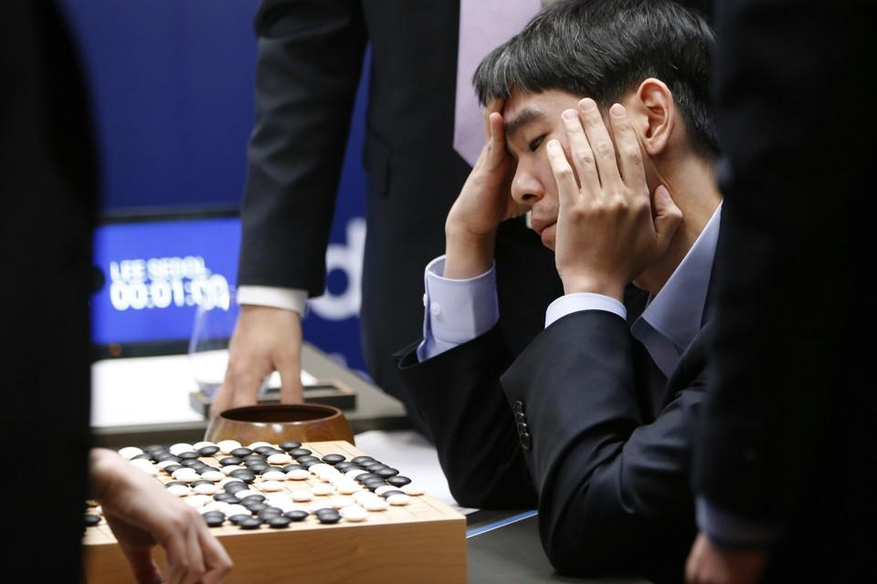
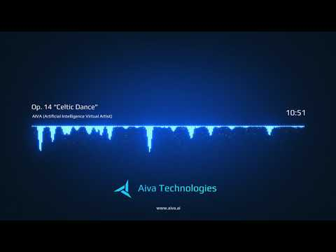
What we have in place today, Weak AI
AI to solve specific problems

Slide 9
85%
31B
$11T
Of customer interactions are projected to be managed without a human by 2020.
Installed base of IoT devices worldwide by 2020
Economic impact of the IoT by 2025, according to estimations by the McKinsey Global Institute

Slide 10
3,327
$5B
$37B
Number of AI companies listed on Crunchbase
Amount venture capital firms invested in AI-related firms in 2017
Amount of total spend in AI by 2025

Slide 11
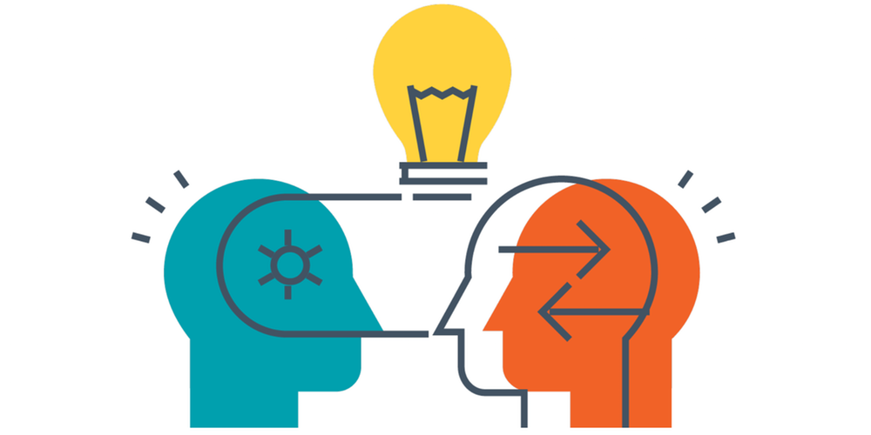
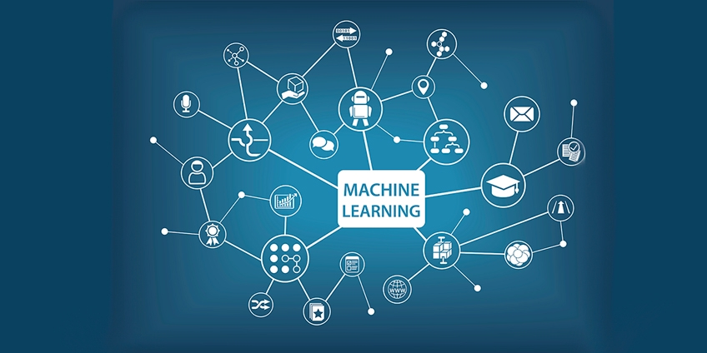
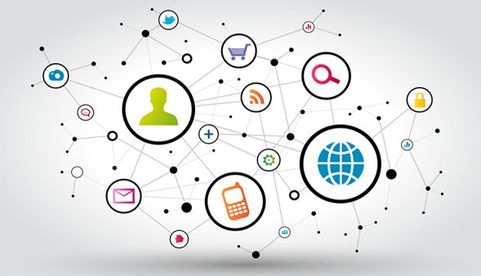
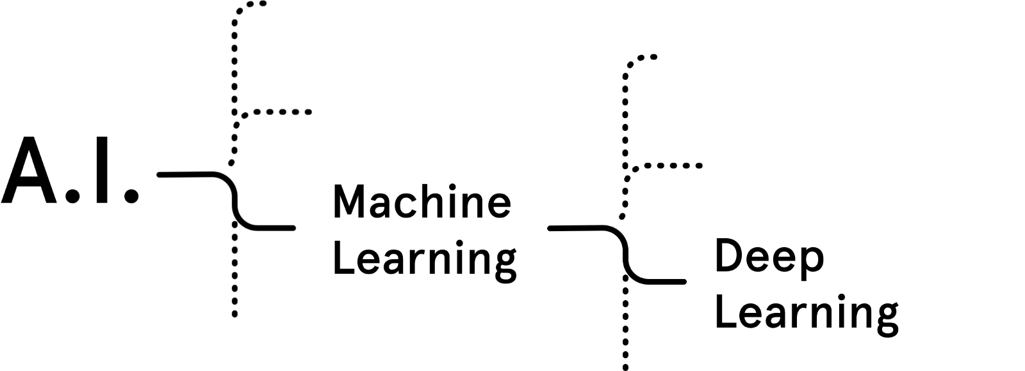
Buzzwords
Natural Language Processing
Context Awareness
Machine Learning
Deep Learning

Slide 12
Machine Learning
Supervised Learning
(Input and Output is specified for training)
Unsupervised Learning
(Only input is given to recognise patterns)
Reinforcement learning
(Real world feedback is provided to system on the go)

Slide 13

Deep Learning
Deep Learning is a type of Machine Learning which includes multiple adjustable blocks to produce better results.
Neural networks is about applying the same rules of human brain to generate intelligence.

Slide 14
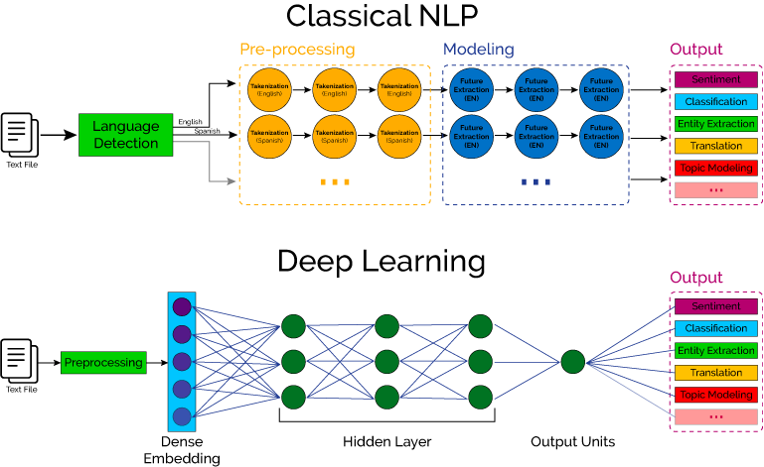
Natural Language Processing

Slide 15
Context Awareness
Adaptation,
filtering of information, invocation of additional services, and deactivation of service components
Personalization,
adapt an application to different persons, such
that they perceive the application differently at the same time
Proactivity,
delivering services to the user on the basis of predictions of future context information

Slide 16
Trends
Rise of Voice Commands in Assistants
As the quest for natural language communication continues, speech-to-text technology has improved immensely.
Siri
Amazon Echo
Google Home

Slide 17
Trends
Content as a Testing Ground
In order to get smarter, AI requires lots of data, patterns and new situations.
Users’ consumption patterns are already being shaped by the machine learning behind Spotify’s “Discover Weekly”, Netflix’s “Recommended For You” and Facebook’s ability to keep you in a filter bubble of your own making.

Slide 18
Trends
AI is learning to be less biased
When a group of scientists recognized that their AI was replicating the human bias (think: “man : computer programmer :: woman : homemaker”) — they broke down the origins of bias and fixed it.

Slide 19
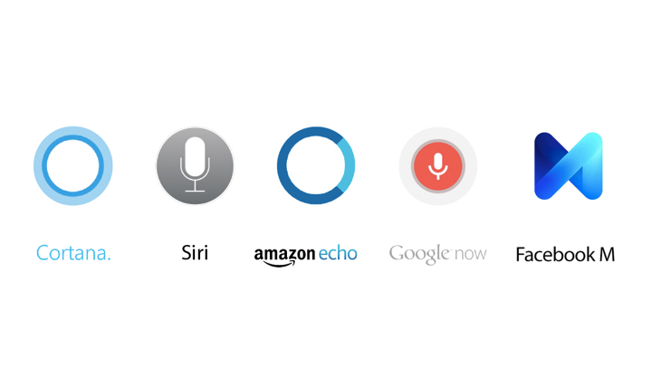
Intelligent Personal Assistants - IPA

Slide 20






Intelligent Personal Assistants - IPA
Speech-To-Text [STT]
Natural Language Processing [NLP]
Artificially Intelligent [AI]

Slide 21
Break
Time for Coffee

Slide 22
Planning our meetings
Schedule
Lab02
Lab03
Lab04
Lab05
In depth AI, NLP, Speech Recognition
Tech to date, 'n' a bit of science,
State of the art solutions
Data play, getting to know our data,
Data manipulations, setting 'em right, setting 'em straight,
Data driven implementation, getting to know the properties of the data,
Picking the right model,
Coding half solutions, Showing the way forward to an app
Code code code
Problem solving and assistance
Create and showcase your own device

Slide 23
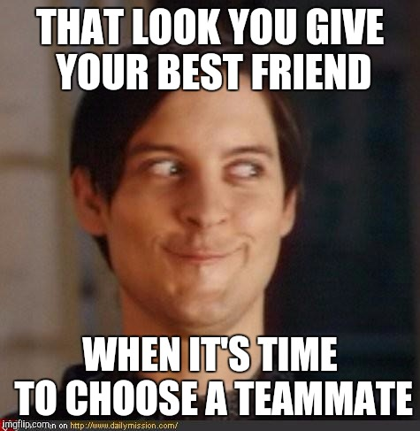
Set our goals, plan, team building

Slide 24
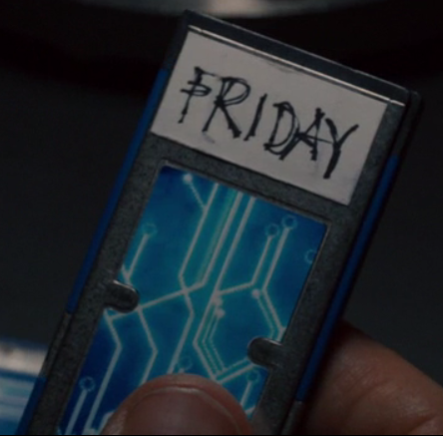
Play time
Time to make me a

Slide 25
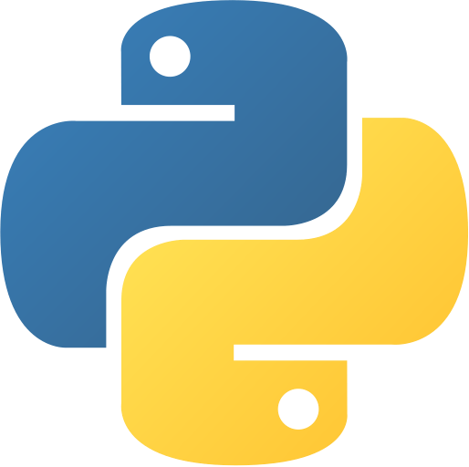


Tech to be used
Python
TensorFlow
Raspberry Pi

Slide 26
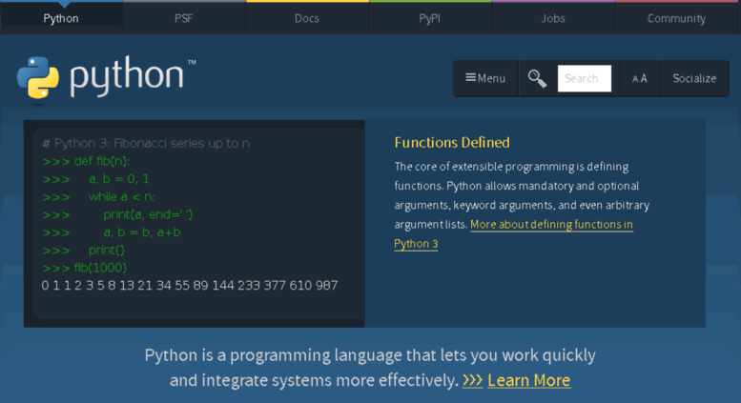
Python
https://www.python.org

Slide 27
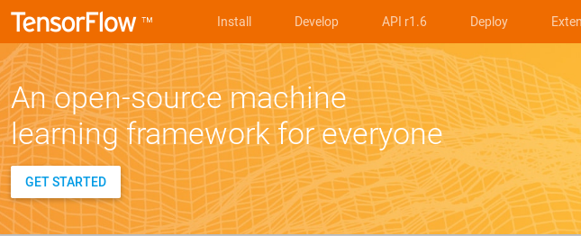
TensorFlow
https://www.tensorflow.org

Slide 28
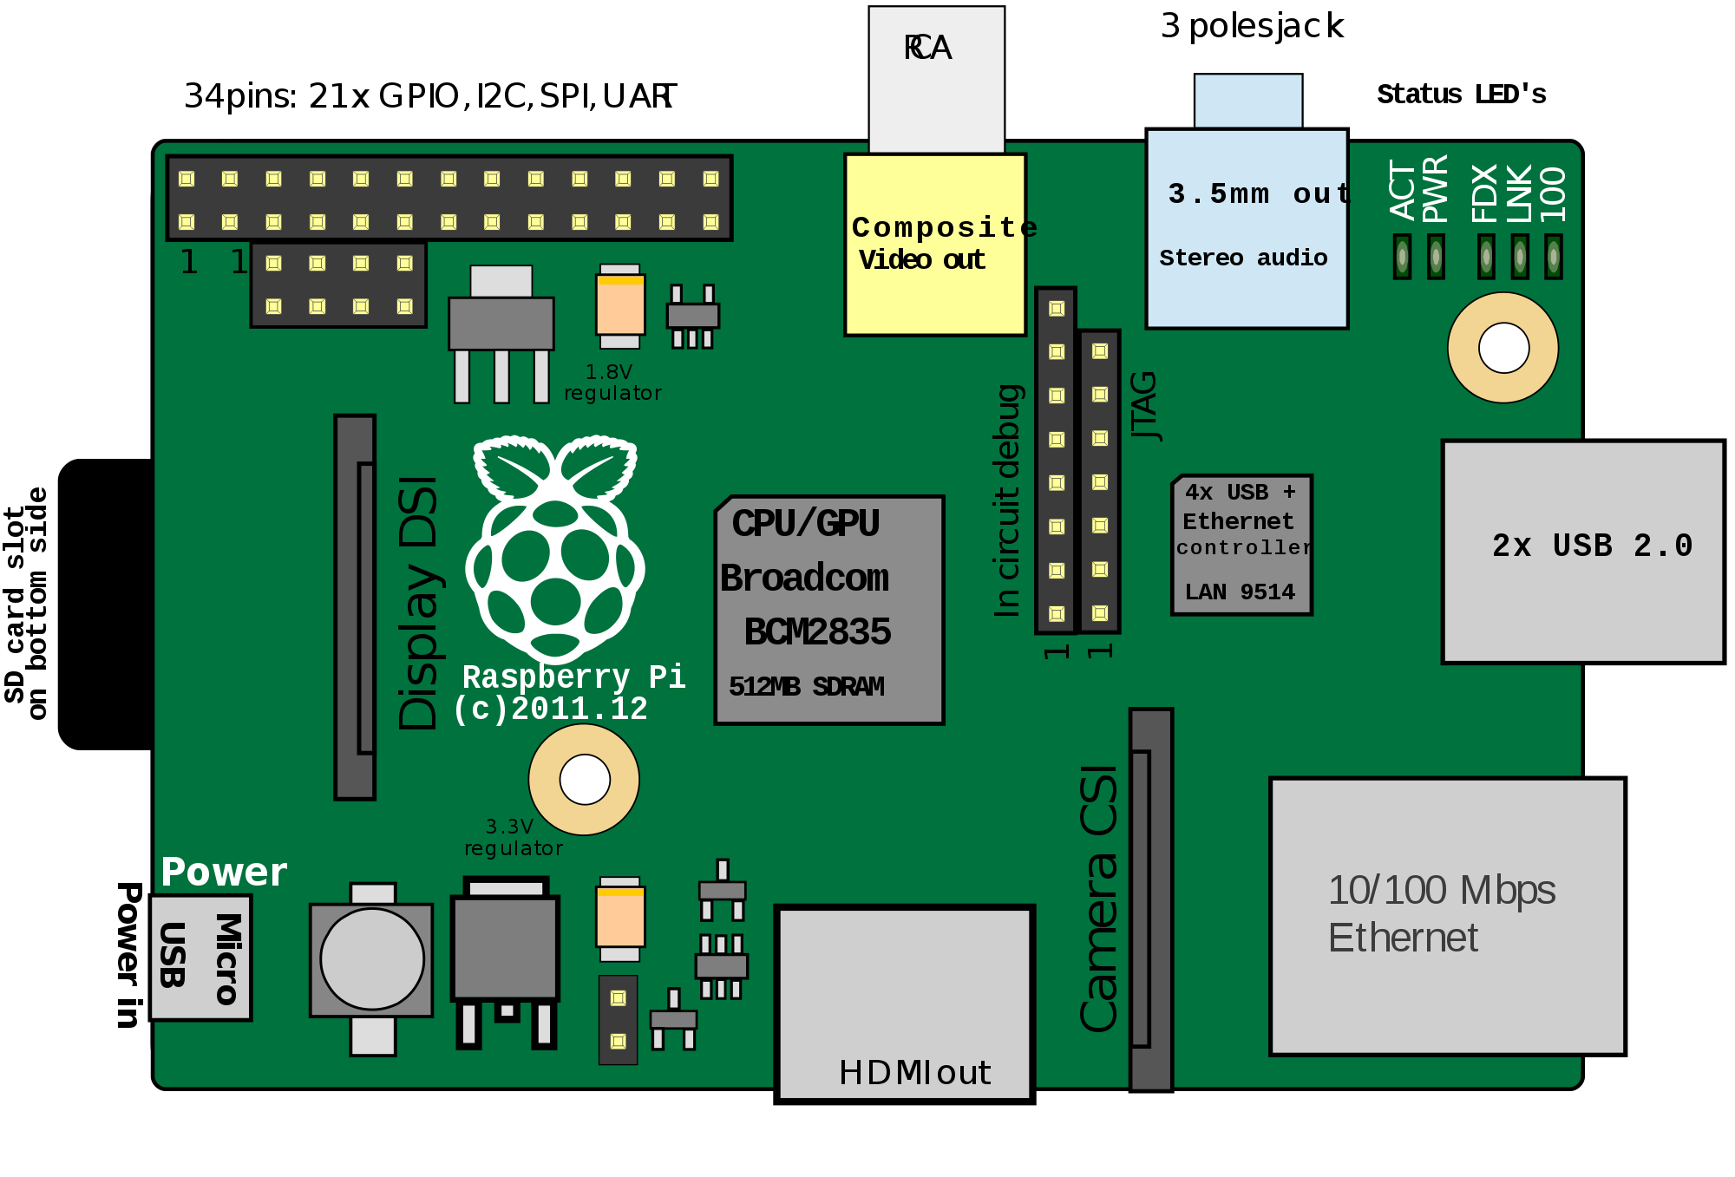
Raspberry Pi
https://playground.tensorflow.org/

Slide 29
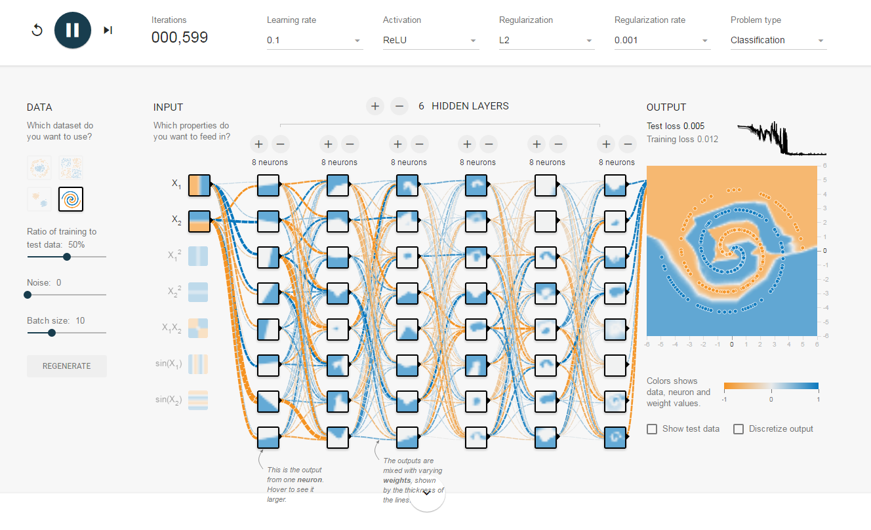
Online Neural Net play
https://playground.tensorflow.org/

Slide 30
https://github.com/melidisc/AI-Lab

